Slide 1
Risk, Chance
Week 6

Slide 2


Slide 3
Uncertainty and Risk
Risk: outcome of action is uncertain
- Perhaps action has random results
- May depend upon opponent’s actions
- Need to know what opponent will do
Two primary means of risk in a game
- Chance and randomness
- Imperfect information

Slide 4
Uncertainty ≠ Skill
Outcomes may depend on player skill
- Hand-eye coordination challenges
- Reaction-time/twitch challenges
- Knowledge of optimal strategies
Varying skill level => uncertain outcomes
- But challenges themselves are predictable
- Player can train at challenge over time

Slide 5
Randomness in Games
Pure randomness is not a good game
- Remember coin flipping
- Player has no meaningful choice
But many games are random
- Candyland, Snakes & Ladders
- Poker, other forms of gambling
- Tetris and other matching, stacking games (not completely)

Slide 6
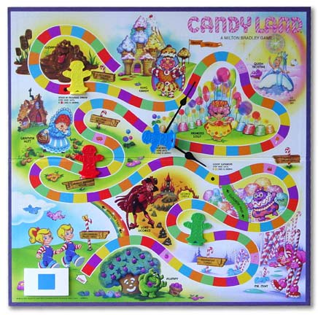
Randomness - Candyland

Slide 7
Randomness with Choice
Tetris pieces are random, but
- Have a choice in how to position them
- “Hedge your bets” to prepare for bad drops
RPG combat is die roll influenced by
- Armor the defender wears
- Weapons the attack uses
- Combat maneuvers employed

Slide 8
Expected Value
Outcome of actions is never the same
- But the sum averages out over many tries
- Strategy: compare average outcomes
Expected Value = outcome × % success
- If many outcomes, sum them together
- Example: Average die roll is 3.5
1×⅙ + 2×⅙ + 3×⅙ + 4×⅙ + 5×⅙ + 6×⅙ = 3.5
Only applies if can do action repeatedly

Slide 9
Is Expected the Best?
Gambling is bad
- House controls expected value
(but varies between games)
- House wins everything (in the long run)
So why do people gamble?
- Expected value only true over many tries
- “Luck” is a factor in (very) short games
- Uncertainty is fun!

Slide 10
Psychology of Randomness
Players favor longshots
- Rare event that has very high payoff
- Will work towards it even if not optimal
- Especially if failure is cheap
Players have “Monte Carlo syndrome”
- After a bad run, expect a good result
- Otherwise, the game is “unfair”

Slide 11
Psychology of Randomness
Payoff influences the perception
- Players remember events with bigger payoff
- Will think it is “more likely”
- Even if two events equally likely
Corollary: Lightning never strikes twice
- A bad outcome is unlikely to happen again
- A good outcome will probably happen again

Slide 12
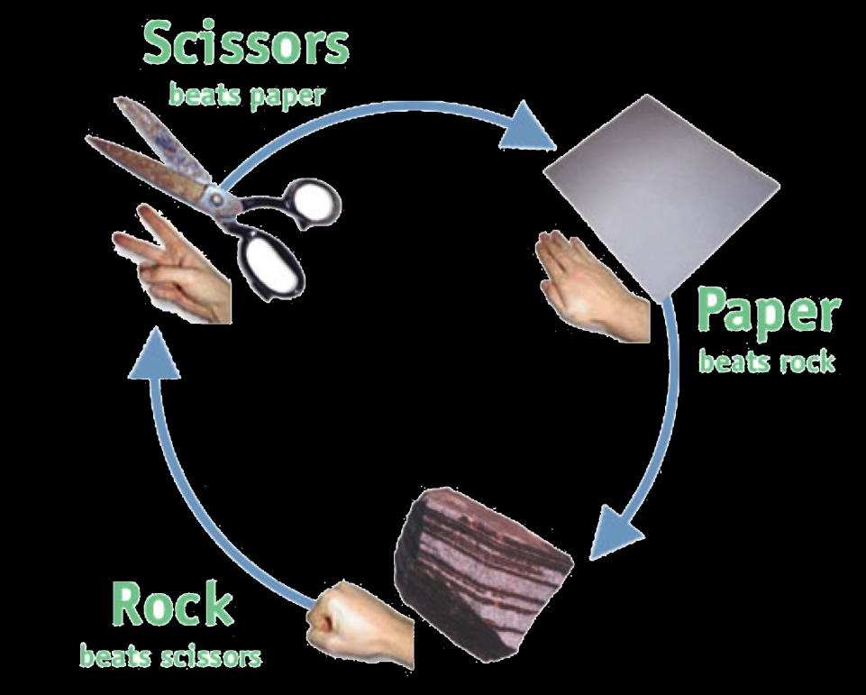
Psychology of Nonrandomness
Players can view the nonrandom as random
Example: paper-scissors-rock
Opponent is uncertain, not random
But there is no choice is better than others
How do you choose?
Any game with heavy negative feedback
“Random” = lack of meaningful choice

Slide 13
Instability vs. Random
Physics can be sensitive!
- Small input change = big output change (nonlinear)
- Games can “feel random”
Instable challenges
- Difficult to repeat success
- Very difficult to tune
- But popular trend in modern puzzle games

Slide 14
Randomness in Fact
Randomness is really an observed property, not something that is absolute.
Numbers are random with respect to each other.
3 3 3 3 3 could be random
Computers generate random numbers using an algorithm. Default gives you the SAME SET of random numbers each time!

Slide 15
Imperfect Information
Player may lack information about that game
- May not know complete game state
- May not know all of the rules
Can reason about likelihood
- Rules eliminate certain possibilities
- Model opponent psychology
- But less precise than probability

Slide 16
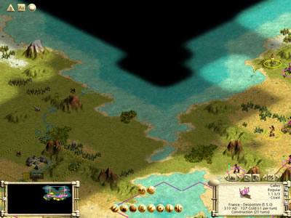
Example: Fog of War

Slide 17
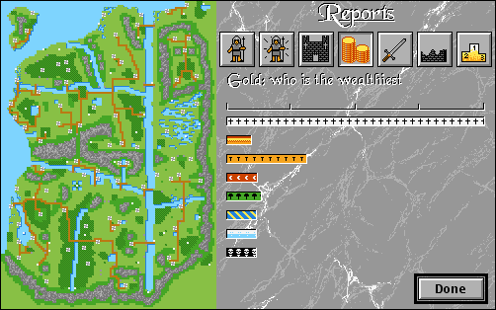
Making Information Imperfect
Hide information
- Fog of war
- Hidden moves
- Hidden die rolls
Generate random noise
- (Partial) scanner jamming
- Inaccurate troop measurements.

Slide 18
Information types
Information known to all players
Information known to one player
Information know only to the game
- Example: the next card in a deck
Randomly generated information
- Example: die rolls

Slide 19
Computers and Information
Very good at managing information
- Can easily hide information from players
Can hide very complex information
- Humans have hard time hiding and managing
- Also, too easy to cheat if hidden
Particularly good at
- Information known only to one player
- Information known only to the game

Slide 20
Randomness vs Imperfect Information
Randomness used heavily in board games
- Nice way to introduce uncertainty/risk
- Easier to manage than imperfect information
But not as important for computer games
- Imperfect information is easy to manage
- Complex rules (physics) may seem random
Deterministic rules are easier to tune
- Even board games realize this (Puerto Rico)

Slide 21
Digital vs. Nondigital Games
Digital Games
Advantages
- Hiding Information
- Complex mechanics
- Long-distance play
Disadvantages
- Adaptability
- Product life span
Nondigital Games
Advantages
- “House Rules”
- Portability/life span
- Multiplayer psychology
Disadvantages
- Complex mechanics
- Hidden information

